Slide 1

“Your Project Name”
Task - 2
“E-Commerce Website”
Task - 2

Slide 2

E-Commerce Search and Filtering System
E-commerce (electronic commerce) is the buying and selling of goods and services, or the transmitting of funds or data, over an electronic network, primarily the internet.
LMS Username
Name
Batch
AMRUTHA.N-BECSE-au112720104005
10
AMRUTHA .N

Slide 3

Taskꢀ-ꢀ2
OBJECTIVES
1. **Component Modularity and Higher Order Components (HOCs):** Break down the design into modular components and implement Higher Order Components for efficient code organization and reusability.
2. **Define Component Structure:** Clearly outline the structure of each component, specifying their relationships and responsibilities within the overall design.
3. **Implement Basic UI Components with Dummy Data:** Set up the foundational UI components using dummy data to ensure the visual representation aligns with the intended design.
4. **API Integration and Error Handling:** Point the base API to the server's base URL, design API calls for each component, and implement robust error handling mechanisms to gracefully manage unexpected issues.
5. **Secure Post API Content:** Implement security measures to safeguard the content of post APIs, ensuring data integrity and protection during transmission and storage.

Slide 4

Step-WiseꢀDescription
Setup React Project
Create Component Structure
Create Base Components
Higher Order Components (HOCs)
Define Component Structure
Set Up Routing
Implement UI Components
Dummy Data Integration
Test and Debug
Refine and Optimize
Documentation
Version Control

Slide 5
Summary of the Task
The task involves setting up a React project by creating a well defined component structure, including base components and Higher Order Components (HOCs). It requires defining the overall component structure, implementing routing, designing UI components, integrating dummy data, testing and debugging the application, refining and optimizing the code, and documenting the project. Additionally, version control is essential to manage changes effectively throughout the development process.

Slide 6
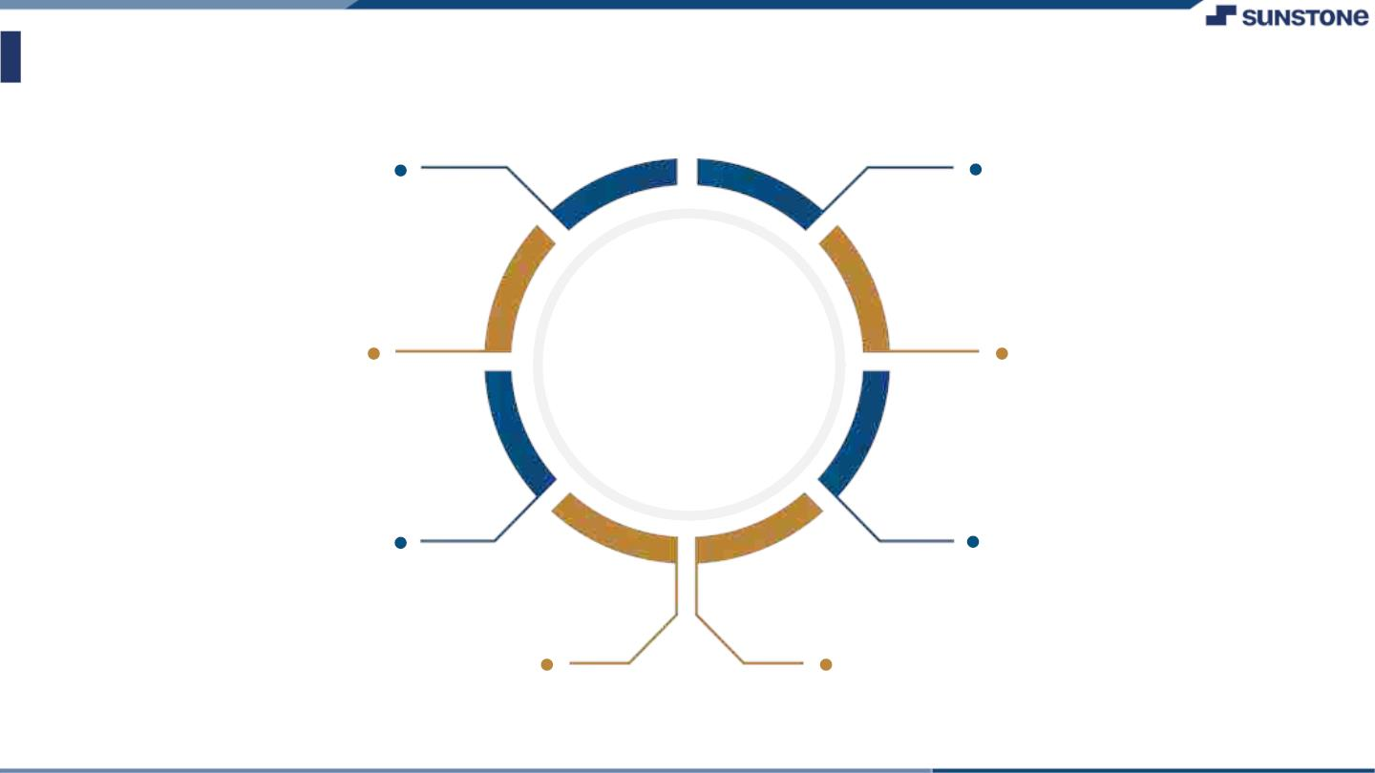
AssessmentꢀParameter
SetupꢀProjectꢀforꢀCalculatorꢀ
project
Setupꢀbasicꢀstructureꢀofꢀtext-
editorꢀproject
Createꢀaꢀmainꢀcomponentꢀwithꢀtheꢀ
outerꢀstructureꢀofꢀcalculator
Check-List
Createꢀmainꢀcomponentꢀwithꢀ
allꢀfeatureꢀbuttons
Createꢀaꢀbuttonꢀcomponentꢀ
withꢀonꢀclickꢀhandler
Createꢀaꢀjsonꢀobjectꢀtoꢀstoreꢀ
dataꢀforꢀtextꢀeditor
Createꢀaꢀ`ꢀevaluateExpresion`ꢀ
functionꢀtoꢀevaluateꢀvalue
Pushꢀbothꢀcodeꢀtoꢀgithub

Slide 7

Submission Github
NM-SPCET-CSE-GROUP10/ at main · AMRUTHABECSE/NM-SPCET-CSE-GROUP10 (github.com)

Slide 8


